Slide 1
Microprogram sequencing
by
Prof. Upendra Mishra
KIET Group of Institutions, Delhi-NCR, Ghaziabad

Slide 2
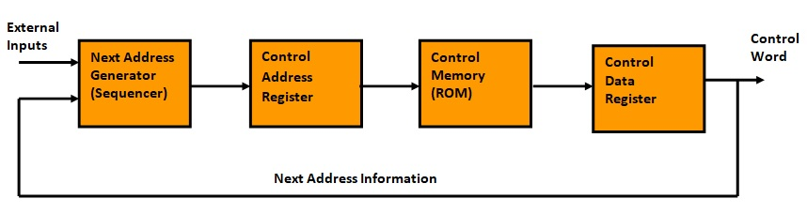
Micro-programmed Control organization
A control memory is assumed to be a ROM, within which all control information is permanently stored.
The control address register (CAR) specifies the address of the micro-instruction and control data register holds the micro-instruction read from the memory.
A microinstruction contains a control word that specifies one or more micro-operations for the processor. Once these operations are executed, the control must determine the next address.
The location of the next micro-instruction may be the one next in the sequence or it may be located somewhere else in the control memory.
The next address generator is sometimes called a micro-program sequencer as it determines the address sequence that is read from memory.

Slide 3
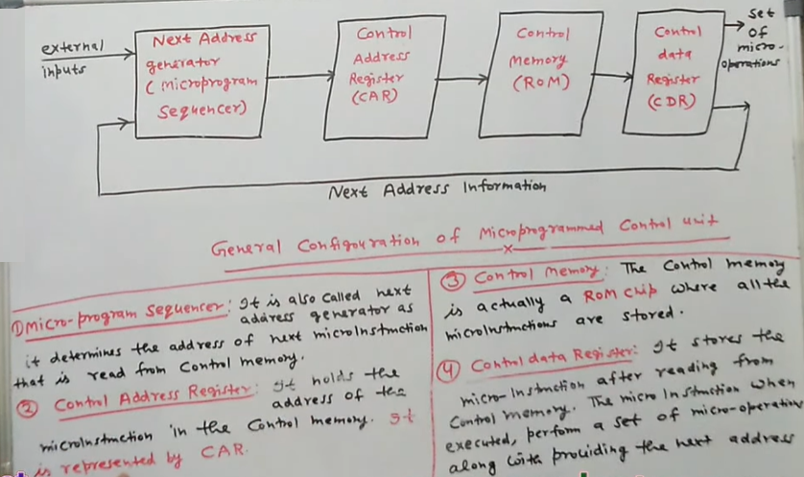

Slide 4
Micro-programmed Control Unit
The basic components of a microprogrammed control unit are:
The control memory
The circuits that select the next address called microprogram sequencer

Slide 5
Microprogram Sequencer
The next address generator is sometimes called a microprogram sequencer, as it determines the address sequence that is read from control memory.
The purpose of a microprogram sequencer is to present an address to the control memory so that a microinstruction may be read and executed. The next-address logic of sequencer determines the specific source to be loaded into the control address register (CAR).
The choice of address source is guided by the next-address information bits that the sequencer receives from the present microinstruction.

Slide 6
Microprogram Sequencer
Typical functions of a microprogram sequencer are:
Incrementing the Control Address Register (CAR) by one
Loading an address from the control memory into the Control Address Register (CAR)
Transferring an external address
Loading an initial address to start the control operations

Slide 7
Methods for generating Address
Increment the Control Address Register.
Unconditional/Conditional Branch depending on status bit flags.
Subroutine Call & return.
Mapping from machine instruction to microinstruction Address.

Slide 8
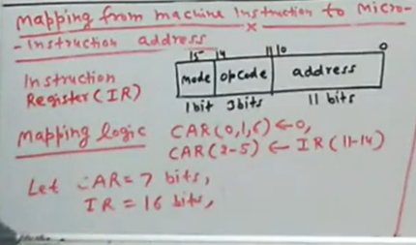
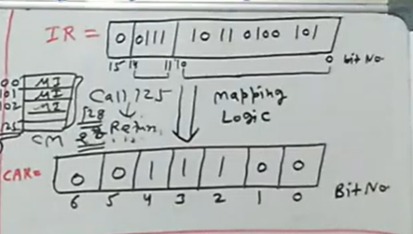
Mapping From Machine Instruction to Microinstruction

Slide 9
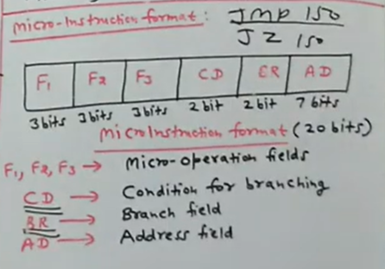
Micro-Instruction Format

Slide 10
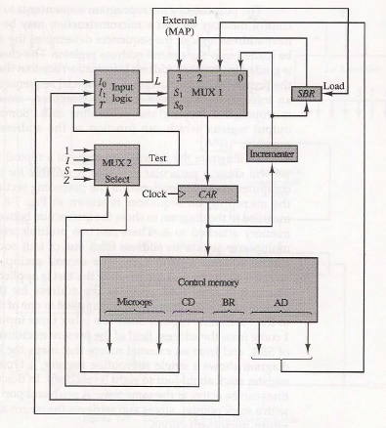
Block Diagram of Microprogram Sequencer
Components of Microprogram Sequencer:
MUX1
MUX2
Input Logic
CAR
SBR

Slide 11
Multiplexer1: (MUX1)
The first multiplexer selects address from one of the following four sources and routes it into CAR.
Incremented
External
from microinstruction
SBR (SubRoutine Register)
S1 | S0 | Selection
0 | 0 | CAR←CAR+1
0 | 1 | CAR←AD
1 | 0 | CAR←SBR (return from Subroutine)
1 | 1 | CAR(2-5)←DR(11-14), CAR(0,1,6)←0

Slide 12
Multiplexer 2: (MUX2)
The second multiplexer tests the value of a selected status bit
and the result of test is applied to input logic.
CD field of microinstruction selects one of the status bit in the second multiplexer.
CD | Condition | Symbol
00 | Always = 1 | U | Unconditional branch
01 | DR(15) | I | Indirect address bit
10 | AC(15) | S | Sign bit of AC
11 | AC=0 | Z | Zero value in AC

Slide 13
Input Logic Design:
The input logic block has three inputs I₀, I₁ and T,
and three outputs S0, S1, and L.
Variable S0 and S1 select one of the source addresses for CAR.
Variable L enables the load input in SBR.
Input Logic equations:
S1= I₁
S0= I₁.I₀+I₁’ T
L= I₁’I₀T

Slide 14
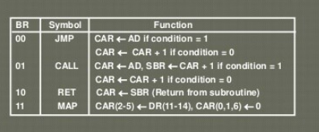

Slide 15
The truth table for input logic is given below:
BR Field |  |  | Input |  |  | MUX1 |  | Load SBR | Function
 |  |  | I1 | I0 | T | S1 | S0 | L
0 | 0 | JMP | 0 | 0 | 0 | 0 | 0 | 0 | CAR←CAR+1
0 | 0 | JMP | 0 | 0 | 1 | 0 | 1 | 0 | CAR←AD
0 | 1 | CALL | 0 | 1 | 0 | 0 | 0 | 0 | CAR←CAR+1
0 | 1 | CALL | 0 | 1 | 1 | 0 | 1 | 1 | CAR←AD, SBR←CAR+1
1 | 0 | RET | 1 | 0 | X | 1 | 0 | 0 | CAR←SBR (return from Subroutine)
1 | 1 | MAP | 1 | 1 | x | 1 | 1 | 0 | CAR(2-5)←DR(11-14), CAR(0,1,6)←0

Slide 16
References
COMPUTER ORGANIZATION AND ARCHITECTURE-DESIGNING FOR PERFORMANCE, EIGHTH EDITION by William Stallings
COMPUTER SYSTEM ARCHITECTURE- THIRD EDITION BY M. Morris Mano

Slide 17
Thank You

